Slide 1
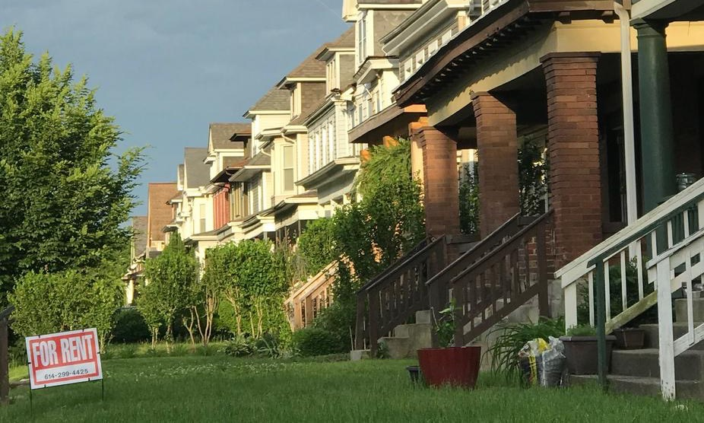
Housing in Ohio
April 2024

Slide 2
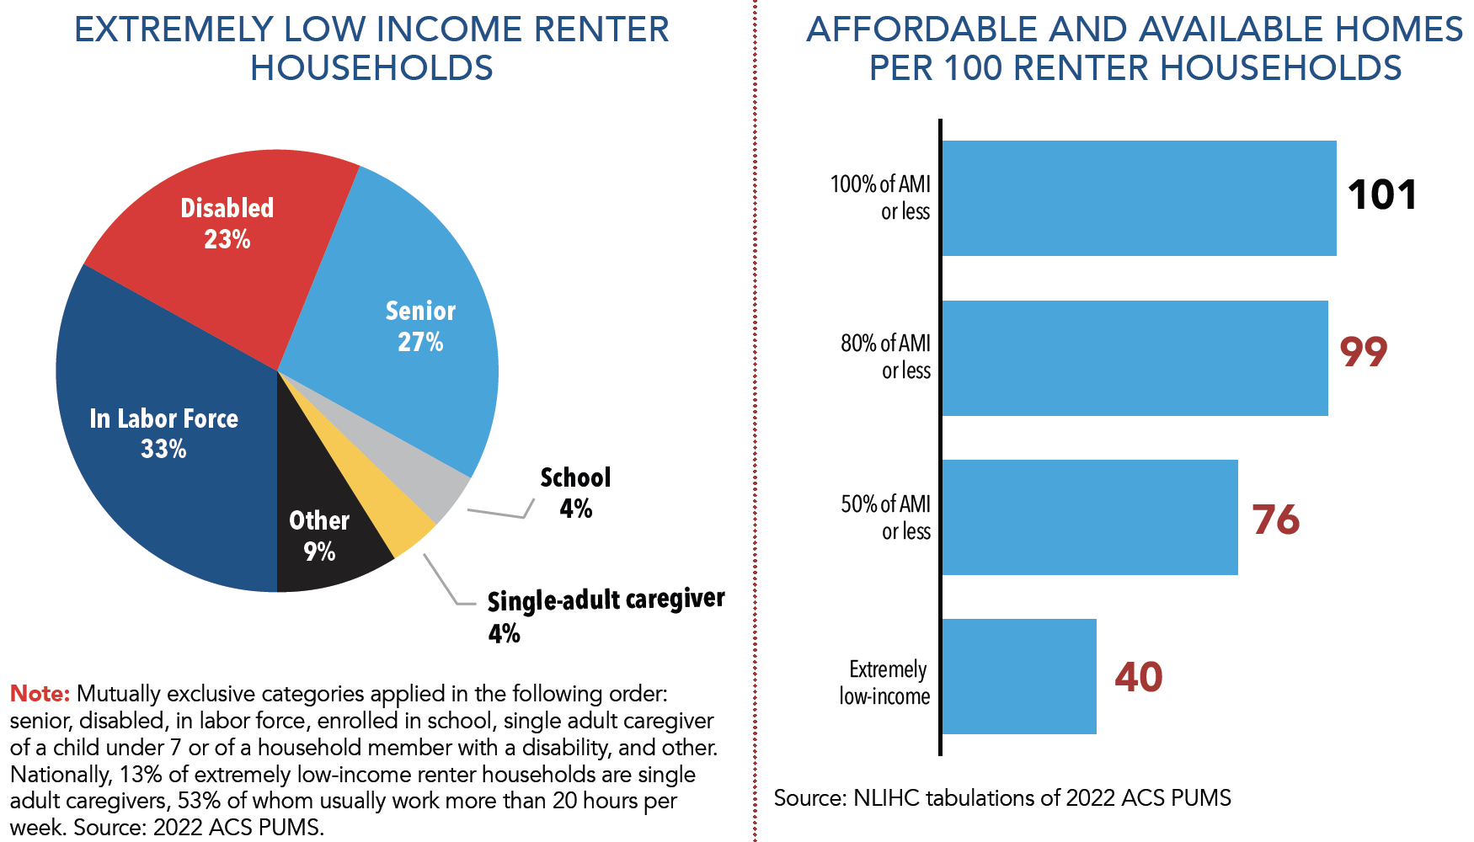
2024 Ohio Housing Profile

Slide 3
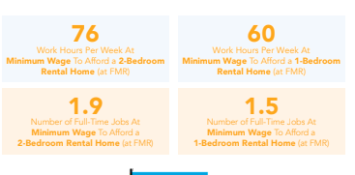

Slide 4
Solution? Advocate for Affordable Housing

Slide 5
Momentum
State Housing Tax Credit
Expanded Ohio Housing Trust Fund
Health Beginnings at Home
Senate Select Committee on Housing

Slide 6
Get Involved
Sign Up for Advocacy Alerts
https://cohhio.org/
Join COHHIO
https://cohhio.org/membership/
Housing Ohio Conference
May 7-8, 2024
https://cohhio.org/conference/

Slide 7
Questions?
Amy Riegel
Executive Director
amyriegel@cohhio.org

